Slide 1
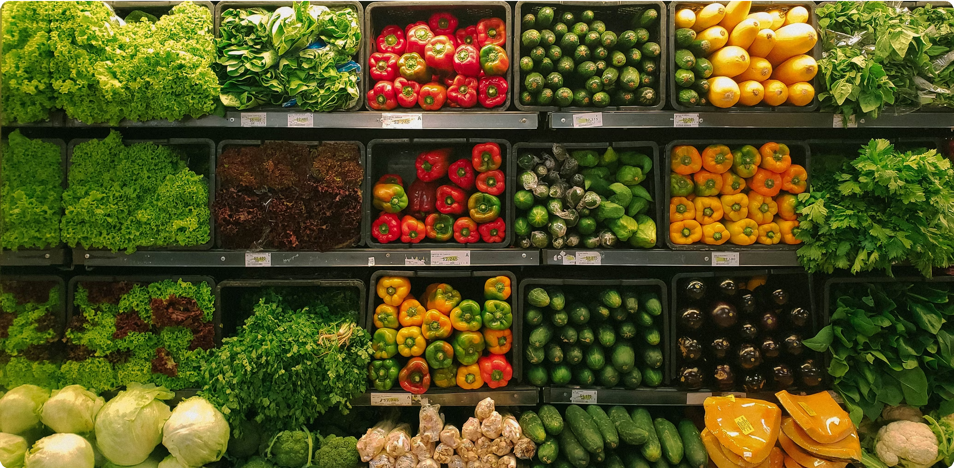
GrocerGenius
A Data-Driven Approach to Grocery Sales Prediction
Data Vista: Sales Data Analysis and Visualization

Slide 2
The Challenge: Navigating the Competitive Grocery Landscape
In the highly competitive supermarket industry, precision in forecasting is not just an advantage—it's essential for survival and growth.
Inventory Imbalance
Traditional forecasting leads to costly overstocking or frustrating stock-outs.
Missed Revenue
Inaccurate forecasting means missed opportunities for maximizing profitability.
Increased Waste
Poor predictions for perishable goods result in significant financial loss.
Our Solution: GrocerGenius — An AI-powered platform that leverages machine learning to deliver precise, actionable sales predictions, transforming raw data into strategic intelligence.

Slide 3
Our Data Foundation
The accuracy of our predictions is built on a comprehensive dataset capturing the key drivers of sales.
Item Details Outlet Details
Item Weight Item Fat Content Item Visibility Item Type
Item MRP (Max Retail Price)
Outlet Identifier
Outlet Establishment Year Outlet Size
Outlet Location Type Outlet Type
Target Variable: Item Outlet Sales
The Machine Learning Pipeline
We engineered a robust, end-to-end pipeline to process the data and build our predictive models.
Raw Data
Handle Missing Values
Feature Engineering
Encode Data
Data Scaling
Predictive Model
→
→
→
→
→

Slide 4
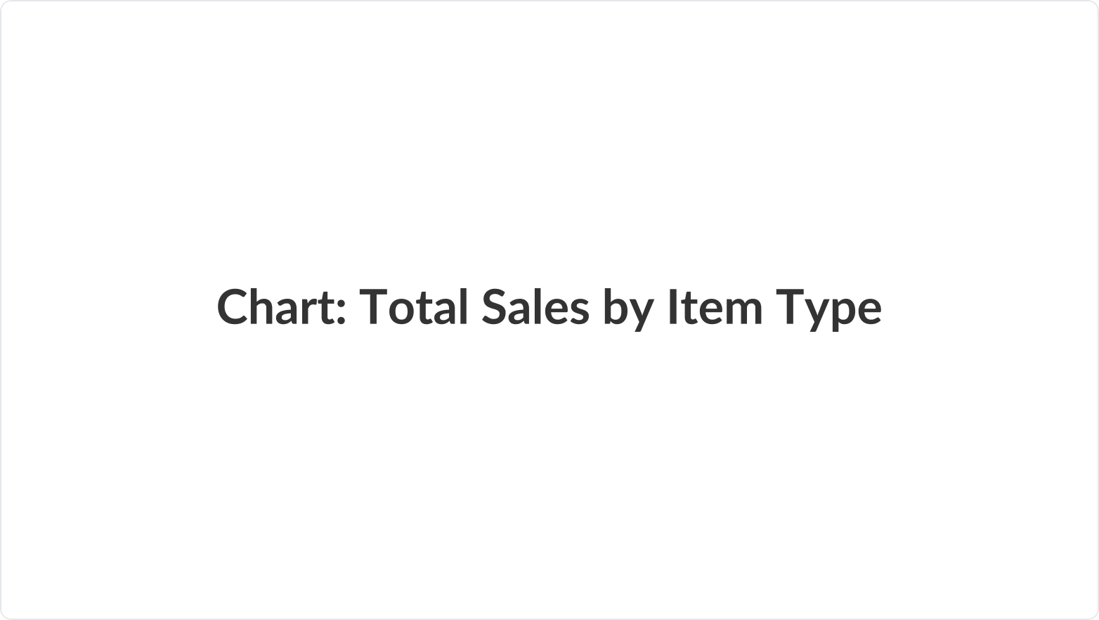
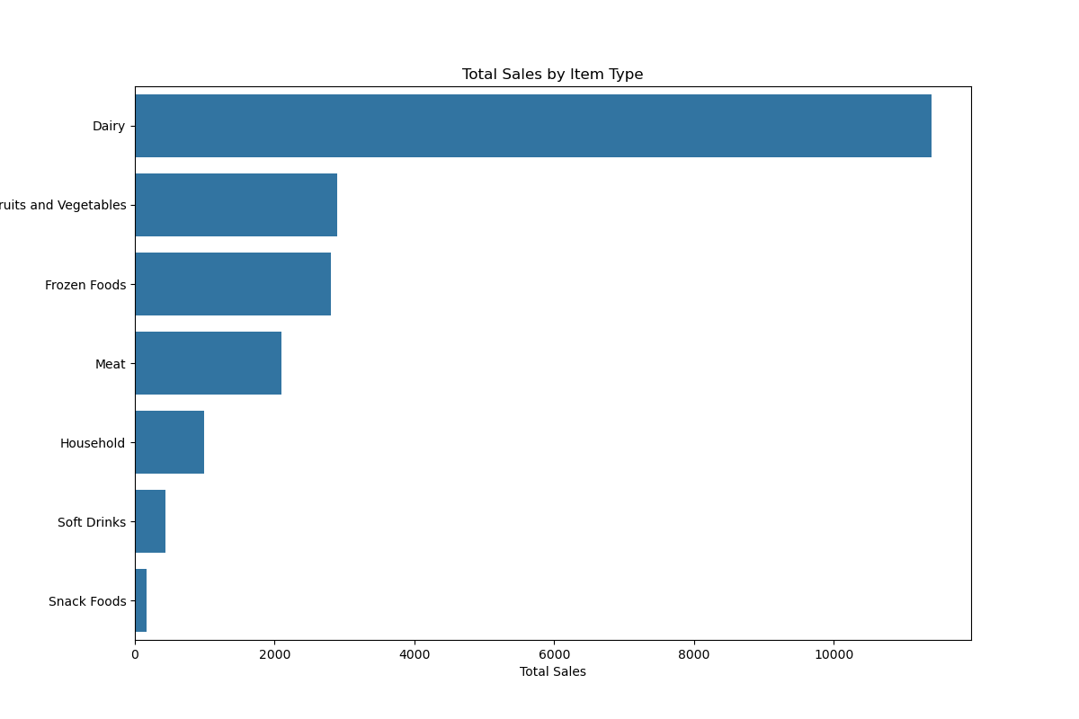
Key Insight: Dairy and Produce Dominate Sales
Exploratory Data Analysis (EDA) reveals that a few key categories drive the majority of revenue.
Total Sales by Item Type
Key Takeaway: Dairy products are the top-performing category by a significant margin, followed by Fruits and Vegetables. This highlights their critical importance to the overall sales volume.

Slide 5
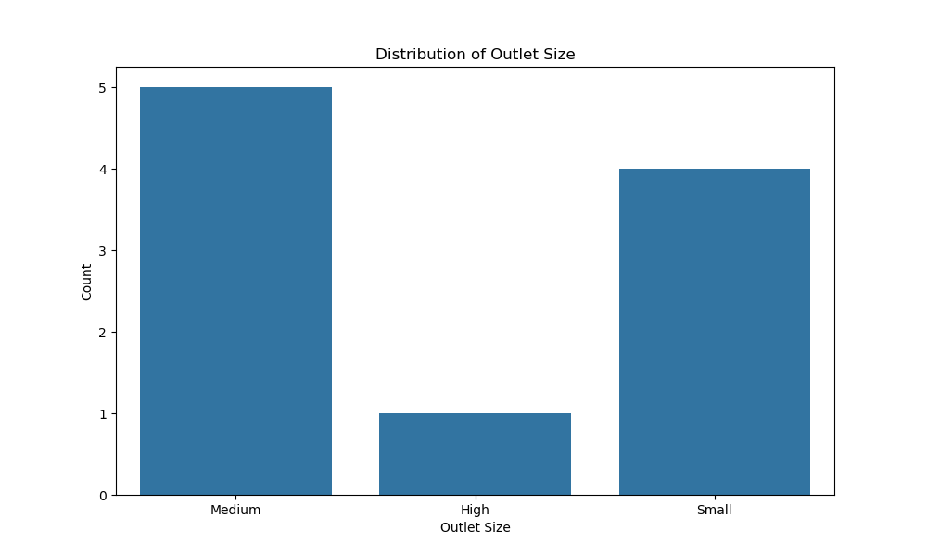
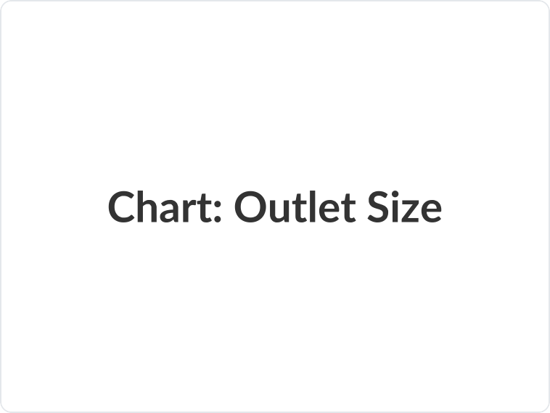
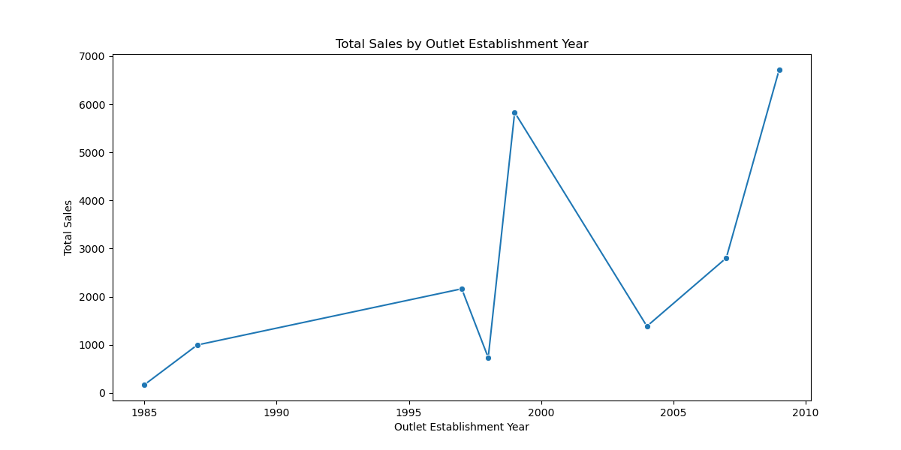
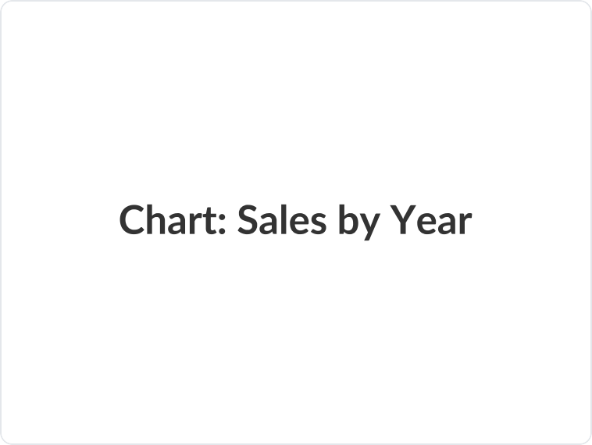
Key Insight: Outlet Size & Age Impact Performance
Our analysis of outlet characteristics shows clear patterns related to store size and establishment year.
Distribution of Outlet Size Total Sales by Outlet Establishment Year
Key Takeaways: Medium-sized outlets are the most common format. Sales performance varies significantly by the year of establishment, with newer and some older stores showing high sales peaks.

Slide 6
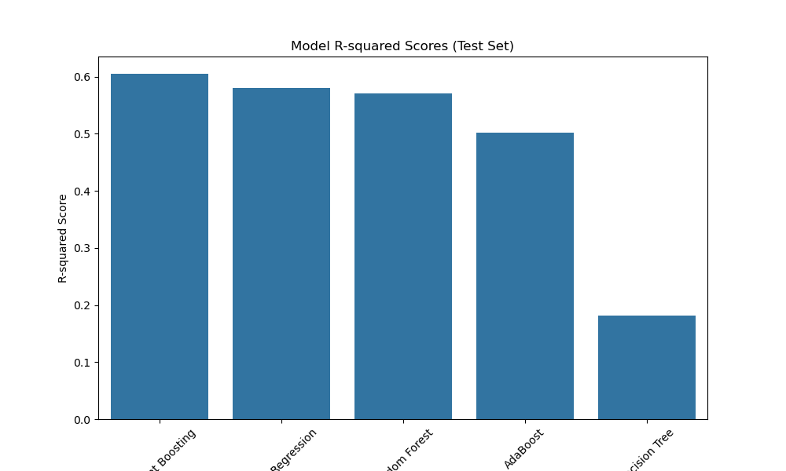
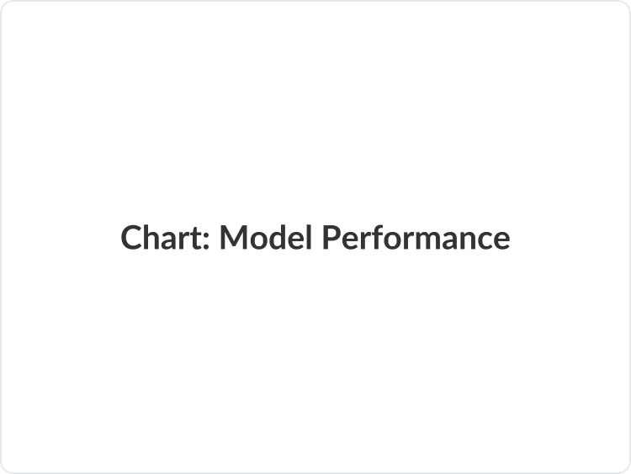
Model Performance: Gradient Boosting Leads the Pack
We evaluated multiple machine learning models to find the most accurate predictor. The Gradient Boosting algorithm demonstrated superior performance.
Model R-Squared Scores (Test Set)
Model | R-Squared Score
Gradient Boosting 60.52%
Linear Regression 57.95%
Random Forest | 57.11%
AdaBoost 50.21%
Decision Tree | 18.13%
Conclusion: The Gradient Boosting model provides the most reliable predictions for our dataset and is the recommended model for production.

Slide 7
Strategic Recommendations for Growth
Based on our model's insights, we propose the following data-driven strategies to boost performance:
Dynamic Pricing
For items with high MRP and low visibility, use the model to identify optimal price points and targeted discounts to maximize sales.
Promotional Bundles
Capitalize on top-selling categories like 'Fruits and Vegetables' and 'Snack Foods' by creating attractive bundled offers to lift sales.
Inventory Optimization
For high-performing outlets, ensure a buffer stock of top-selling items to prevent stock-outs, especially during peak seasons.
Localized Campaigns
Acknowledge that 'Grocery Store' format outlets have unique sales patterns. Develop localized marketing campaigns to meet their specific demand.

Slide 8
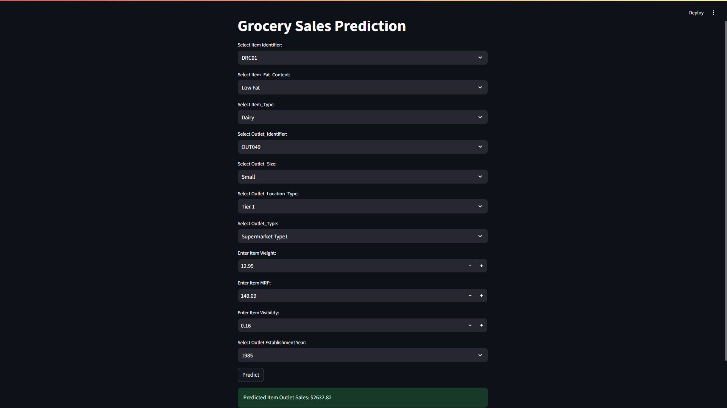

GrocerGenius in Action: Prediction UI
A preview of the interactive tool that puts the power of our predictive model directly into the hands of decision-makers.

Slide 9
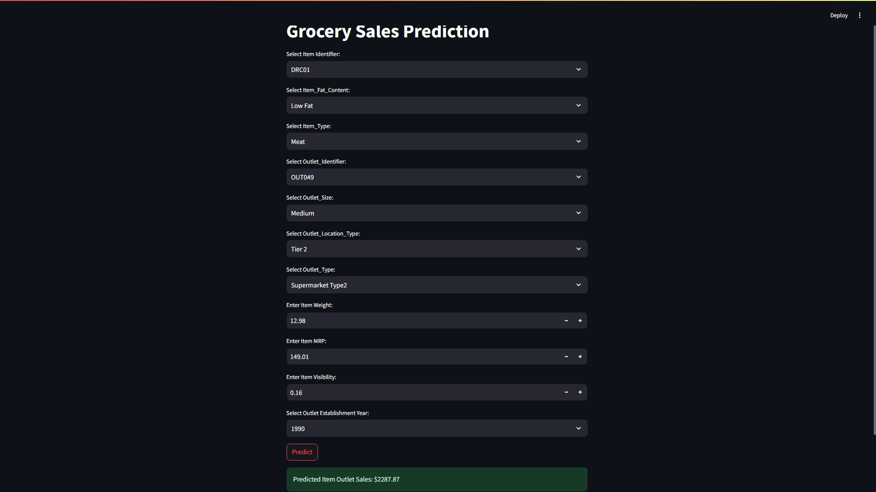


Slide 10
Conclusion: Driving Profitability with Data
Project Summary: GrocerGenius successfully delivers an end-to-end machine learning pipeline for predicting supermarket sales with a high degree of accuracy, empowering strategic, data-informed decisions.
Business Value Proposition:
Revenue Optimization Drastically reduce losses from stock-outs and overstocking.
Improved Efficiency Streamline inventory management and supply chain operations.
Enhanced Marketing Leverage data-driven insights for targeted, high-ROI promotions.

Slide 11
Acknowledgements
We would like to express our heartfelt gratitude to our mentor, Sir Vijaykumar, for his invaluable guidance and support. Our thanks also go to everyone at Infosys Springboard who contributed to this project.
Thank You
Lovesh Munet (Intern)
Project Contributor

